Slide 1
Meeting the Needs of ELLs in CTE
Region One ESC
March 24, 2017
Ed Garcia, M. Ed.
CTE Specialist
Region One ESC
Karina E. Chapa, M. Ed.
Language Proficiency, Biliteracy
and Cultural Diversity Director
Region One ESC

Slide 2
Professional Learning Essential Agreements
Be respectful of others
Be an active participant
Take care of your needs
Use electronic devices as learning tools

Slide 3
Session Objectives
Content Objective
Language Objective
Today I will explore sheltered instruction techniques and strategies to make content comprehensible for my ELLs.
Today I will share different ideas on how to implement sheltered instruction strategies in my classroom.

Slide 4
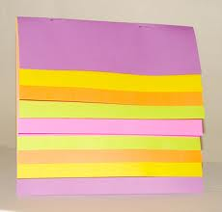
Keep It Together!
Sheltered
Instruction
Sketching Notes

Slide 5

Make an Appointment

Slide 6
The Power of Language
Cognitive
Social
Affective
“Language stands at the center of the many interdependent cognitive, affective, and social factors that shape learning”.
David Corson, 1999
LANGUAGE
=
IDENTITY
Small Group

Slide 7
The Iceberg Theory
Basic Interpersonal Communication Skills
BICS
1-3 years
5-7 years
CALP
Cognitive Academic Language Proficiency
J. Cummins, 1981

Slide 8
Double Iceberg Theory
BICS L1 1-3 years
BICS L2 1-3 years
CALP L1+L2 5-7 years
J. Cummins, 1981

Slide 9
Research Findings
The stronger academically and cognitively the L1, the stronger the L2.
The weaker academically and cognitively the L1, the weaker the L2.
W. Thomas & V. Collier, 2009
Turn and Talk
Think-Pair-Share

Slide 10
My Language Profile
BICS Spanish
BICS English
CALP Spanish + English
1999

Slide 11
My Language Profile
BICS Spanish
BICS English
CALP Spanish + English
2016

Slide 12
Your Turn!
BICS L1
BICS L2
CALP L1+L2
Create your own language profile
Birthday Line

Slide 13
Keep It Together!
Sheltered
Instruction
Sketch it!
BICS vs CALP

Slide 14
ELPS: LIAG
Using the ELPS to Linguistically Accommodate Instruction

Slide 15
Statutory Requirement
19 Texas Administrative Code 74.4 Chapter 74. Curriculum Requirements Subchapter A. Required Curriculum 74.4 English Language Proficiency Standards
Adopted December 2007

Slide 16

ELPS Academy
LIAG

Slide 17
TEKS vs ELPS
STAAR
TELPAS
T
E
K
S
E
L
P
S

Slide 18
TEKS vs ELPS
Academic Proficiency Language Proficiency
STAAR
TELPAS
TEKS
ELPS
Relating Factor: evaluates/measures

Slide 19
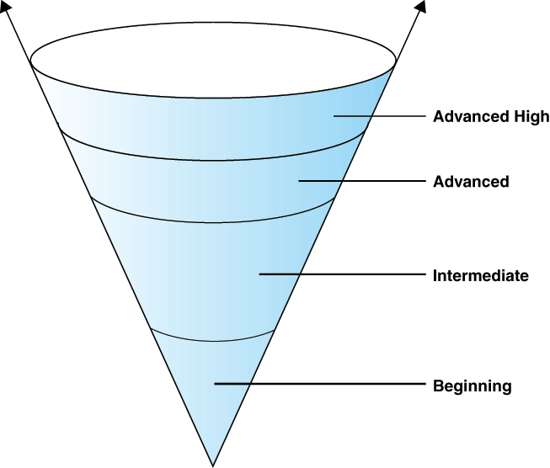
TELPAS
Language Acquisition Levels
12 o’clock

Slide 20
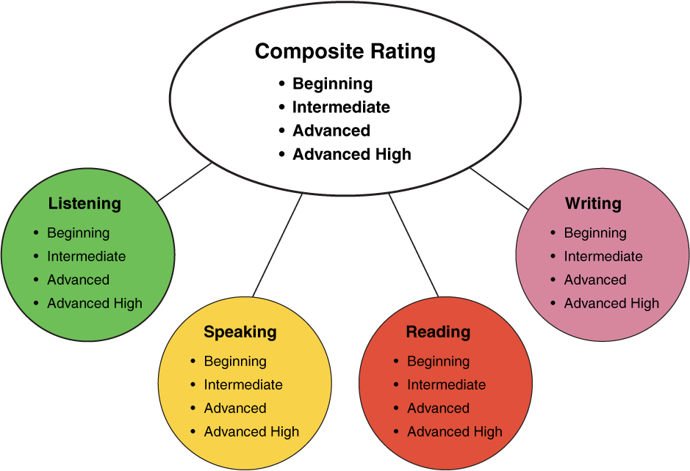
TELPAS Domains
10%
30%
10%
50%

Slide 21
ELPS
Big Ideas
1. Make Content Comprehensible
2. Develop Academic Language
Big Responsibilities
1. Communicated
2. Sequenced
3. Scaffolded
Student Expectations
1. Listening
2. Speaking
3. Reading
4. Writing
5. Learning Strategies
PLDs (L, S, R, W)
1. Beginning
2. Intermediate
3. Advanced
4. Advanced High
How are they organized?

Slide 22
ELPS Mingle!
Form groups of 4
Read assigned area and create visual representation:
  Listening PLDs
  Listening Expectations & CCRS
  Listening Teacher Behaviors
  Speaking PLDs
  Speaking Expectations & CCRS
  Speaking Teacher Behaviors
  Reading 2-12 PLDs
  Reading Expectations & CCRS
  Reading Teacher Behaviors
  Writing 2-12 PLDs
  Writing Expectations & CCRS
  Writing Teacher Behaviors
Expert Groups
Notes:
1.5 hours after the gallery - BREAK

Slide 23
Talk to your shoulder partner
Knowing the impact that TELPAS has on accountability, how can we use this data to improve student performance?

Slide 24
ELPS Academy
LIAG
+
DMAC Reports

Slide 25
DMAC
Go to Home Page
Go to State Assessment
Select TELPAS
Select Instructional Reports
Select Student Language Proficiency Rating
Generate Report
TELPAS Reports

Slide 26

Sample DMAC Report

Slide 27
Keep It Together!
Sheltered
Instruction
Sketching Notes
BICS vs CALP
ELPS

Slide 28
Sheltered Instruction

Slide 29
Three-Step Interview
Stand up when you can complete one of these sentences:
  Teaching ELLs is so difficult because…
  One challenge I face when teaching ELLs is…
  One challenge I face when instructing ELLs is… What I have done to overcome this challenge is…
Beginner
Intermediate
Advanced

Slide 30
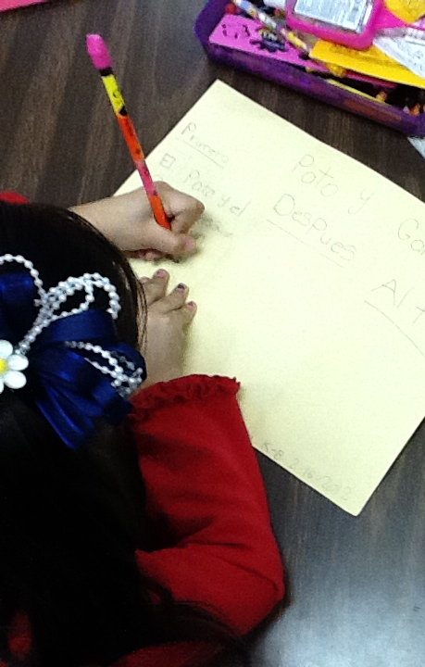
What are the two goals of Sheltered Instruction?
Make content comprehensible
Develop Academic Language

Slide 31
Content and Language Objectives

Slide 32

Anticipation Guide
kahoot.it
create.kahoot.it
Let’s Kahoot!

Slide 33
The What and the How
Content Objectives come from the TEKS
What am I going to learn?
Language Objectives come from the ELPS
How will I demonstrate my learning through listening, speaking, reading and/or writing?
Content and Language Objectives

Slide 34
Content Objective - Sample
Science TEKS: Differentiate between structure and function in plant and animal cell organelles including cell membrane, cell wall, nucleus, cytoplasm, mitochondria, chloroplast and vacuole.
Student Friendly format: Today I will compare and contrast the cell structures and functions of plants and animals.

Slide 35
Writing Content Objectives
Pair-up
Analyze a Student Expectation from your TEKS
Write it in a student-friendly format
You have 2 minutes

Slide 36
Language Objective - Sample
Content Objective:
Today we will compare and contrast the cell structures and functions of plants and animals.
Language Objective:
Today we will write an essay comparing and contrasting plant and animal cells utilizing transitional phrases.

Slide 37
Writing Language Objectives
Pair-up
Look back at the content objective you wrote
Write a language objective in a student-friendly format
Use your ELPS tools for ideas
You have 2 minutes
Share both objectives with your 3 o’clock

Slide 38
Key Points to Remember
Make objectives student friendly and appropriate for grade level
Objectives are for students, not for the adults in the classroom
Post eye level
Review with students before, during and after each lesson

Slide 39
Keep It Together!
Sheltered
Instruction
Sketching Notes
BICS vs CALP
ELPS
Content/Language Objectives

Slide 40
Randomization Techniques

Slide 41
Write-Read-Read-Trade
1. Stand up when you complete in writing one of these sentences:
  I select who I call on by…
  In my classroom, I include randomization because…
  The most beneficial randomization technique I have used is… because…
  2. Find someone who was not next to you, share your answers and trade your papers.

Slide 42
Randomization Techniques
Randomize and rotate who is called on,
so students of all language levels can participate
Is it possible to randomize and differentiate instruction at the same time?

Slide 43
Randomization Techniques
Lucky sticks
Beach ball
Index cards
with student names
Class list/roster
Color/numbers
Birthdays
Physical characteristics: longest hair, eye color…
Jenga
Pick up sticks
Career cards
Apps
Popcorn

Slide 44
Keep It Together!
Sheltered
Instruction
Sketching Notes
BICS vs CALP
ELPS
Content/Language Objectives
Randomization

Slide 45
Total Response Signals

Slide 46
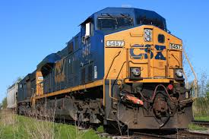
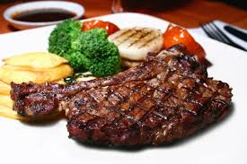
Total Response Signals
Why is it important to check for understanding along the way?

Slide 47
Written Responses
Hold up paper
White boards
Ready Responses
Hands up when ready
Personal Chalkboards
Answers on cards
Thinker’s chin
Stand up when ready
Put your pen on your paper when ready
All eyes on teacher
Making Choices
Open hand/closed hand
Ranking
Rank with your fingers
Thumbs/Pens up/down
Number wheels
Green card/red card
Move to the corner/spot
Rank with your arm
Line up according to response
Knocking/clapping/
cheering

Slide 48
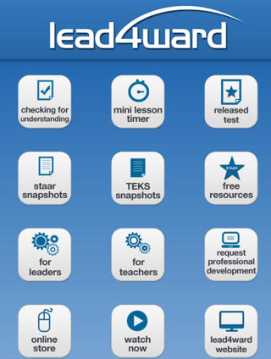
Lead4Ward App
Checking for Understanding

Slide 49
Find the Fib!
Students may work in pairs or small groups.
Students have three post-its/index cards with the numbers “1, 2, 3” in each card.
Teacher writes 3 statements on the board (one false, two true) and students decide which one is the fib.
On signal from teacher, students show the number of the statement they believe is the fib.

Slide 50
Let’s Play!
Evaporation is part of the water cycle
Refraction is part of the water cycle
Condensation is part of the water cycle
      I believe number… is a fib because…
Find the Fib

Slide 51
Let’s Play!
Rhea is a moon of Saturn. Which of these facts about Rhea best indicates that it does not have a water cycle in which water changes state?
A Its radius is 765 km.
B Its density is about 1.3 kg/m3.
C Its period of rotation is about 4.5 Earth days.
D Its temperature is between −174°C and −220°C.
Find the Correct Answer

Slide 52
Keep It Together!
Sheltered
Instruction
Sketching Notes
BICS vs CALP
ELPS
Content/Language Objectives
Randomization
Total Response Signals

Slide 53
The Power of Cognates
Notes:
3 hours

Slide 54
The Power of Cognates
La chimica è la scienza che studia la composizione della materia ed il suo comportamento in base a tale composizione.
Make a list of all words that are similar in English or Spanish and Italian

Slide 55
The Power of Cognates
La chimica è la scienza che studia la composizione della materia ed il suo comportamento in base a tale composizione.
Make a list of all words that are similar in English or Spanish and Italian

Slide 56

Your Turn!
1. Individually make a list of 10 academic words from your particular content area.
2. Turn to your partner and combine your two lists of words (even if from different content areas).
3. Find another pair and exchange your lists.
4. Write the Spanish cognates next to each academic word. Use iTranslate or Google Translate as needed.
5. Calculate what percentage of the words are cognates.
1 – 2 – 4 – ALL
http://www.realfastspanish.com/vocabulary/spanish-cognates

Slide 57
Keep It Together!
Sheltered
Instruction
Sketching Notes
BICS vs CALP
ELPS
Content/Language Objectives
Randomization
Total Response Signals
Cognates

Slide 58
Developing Academic Vocabulary

Slide 59
1. When you can complete this sentence in your mind, please stand up.
Academic vocabulary development is important for ALL students, but especially for ELLs, because…
2. Find your 9 o’clock appointment and share your responses.

Slide 60
What does this mean?
Carving is appropriate for most green and blue slopes and even some black slopes. However, if you try to carve through moguls, especially in packed powder or corn snow, you’re going to face-plant.

Slide 61
What does this mean?
Carving is appropriate for most green and blue slopes and even some black slopes. However, if you try to carve through moguls, especially in packed powder or corn snow, you’re going to face-plant.

Slide 62
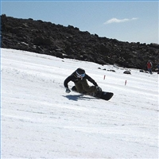
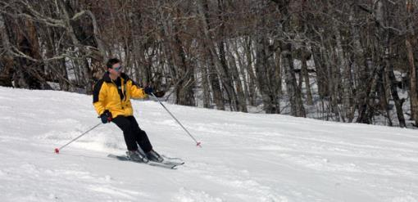
Would this help?
These men are carving.

Slide 63
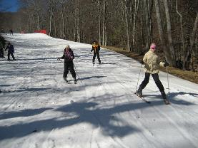
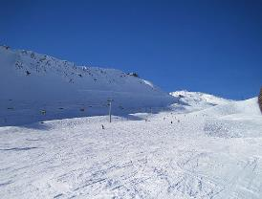
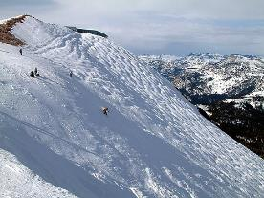
How about this?
Green Slope
Blue Slope
Black Slope

Slide 64
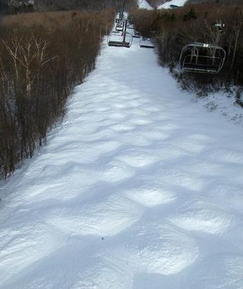
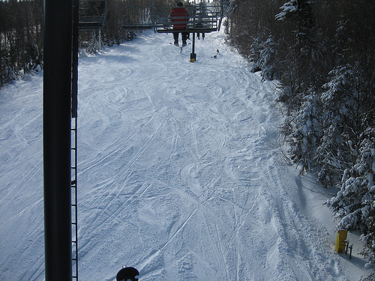
Moguls Packed Powder

Slide 65
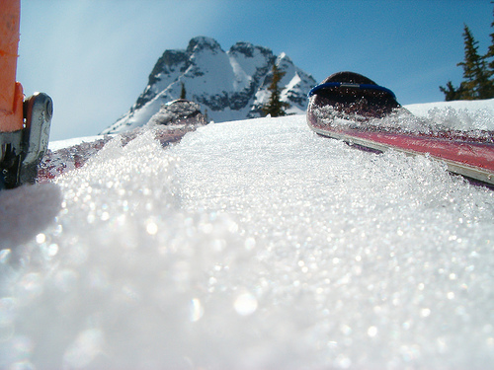
Corn Snow

Slide 66
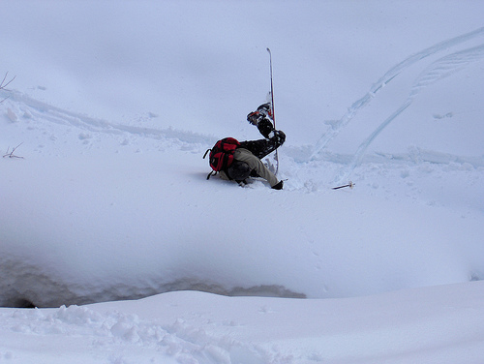
Face-plant

Slide 67
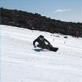








Carving is appropriate for most green and blue slopes
and even some black slopes. However, if you try to carve
through moguls, especially in packed powder or corn snow
you’re going to face-plant.
apropiado
especialmente

Slide 68
Vocabulary Gallery
Each table researches a different vocabulary strategy
Each team creates a poster explaining the activity
Divide the teams in expert groups and walk the gallery
Expert Gallery Walk
Notes:
3.5 hours

Slide 69
Keep It Together!
Sheltered
Instruction
Sketching Notes
BICS vs CALP
ELPS
Content/Language Objectives
Randomization
Total Response Signals
Cognates
Academic Vocabulary

Slide 70
Session Objectives
Content Objective
Language Objective
Today I explored sheltered instruction techniques and strategies to make content comprehensible for my ELLs.
Today I shared different ideas on how to implement sheltered instruction strategies in my classroom.

Slide 71
One Last Time!
I used to think…
But now I know…
Tickets Out

Slide 72
Thank you for your participation!
KARINA E. CHAPA, M. ED.
KCHAPA@ESC1.NET
FACEBOOK: REGION ONE ESC BILINGUAL
TWITTER @BILINGUALPRIDE @ESC1BILINGUAL

